Slide 1

MMC Fitness
Project number: 220310
Workshop: Home Communications
Mentor: Toma Gaber
Students:
May Ovadia
May Tzadoky
Chen Shitrit

Slide 2
Problem Description:
As of 2022, about a billion people are obese. About 650 million adults, 340 million teenagers,
39 million children and these numbers are only rising.
Over the years we become less healthy and suffer more from overweight and health problems because of it.
The solution is referring to every person that desiered to live a healthy life.
Our solution address also the ones that have physical limitation and Dietary restrictions .

Slide 3
Solution:
Our solution to the problem is to create a website that combines nutrition with fitness.
It is well known that a way to a healthy lifestyle combines nutrition and fitness training,
That is why our website brings together all the levels.
The algorithm of our website considers the limitations of the user who has registered and wants to start a process.
If the registrant has dietary restrictions and/or physical limitations, the menus and fitness training that will suit him will be following what he entered in the registration, and each step of the process will be able to update his details according to the changes.
By using our website, people will be able to lower their BMI, get in shape, and be healthier.

Slide 4
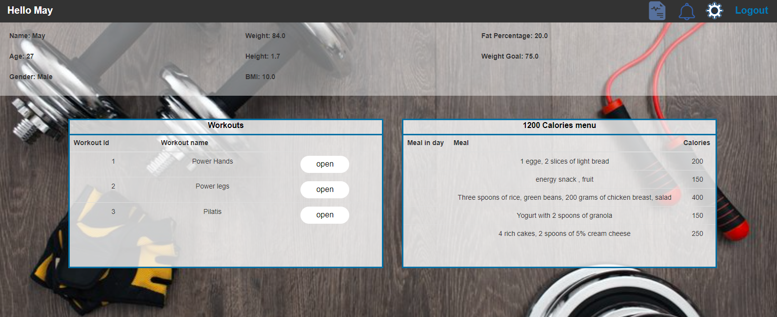
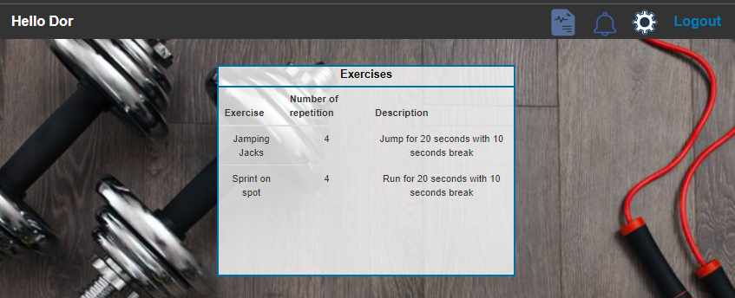
MMC Fitness combine fitness and physical exercises both in one place.

Slide 5
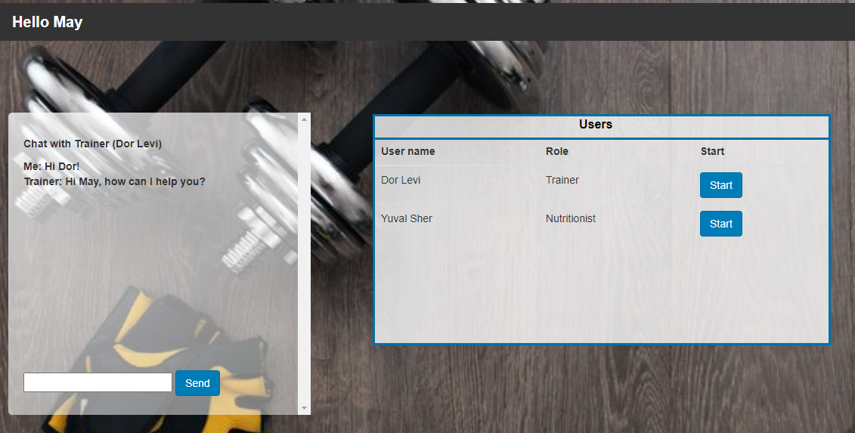
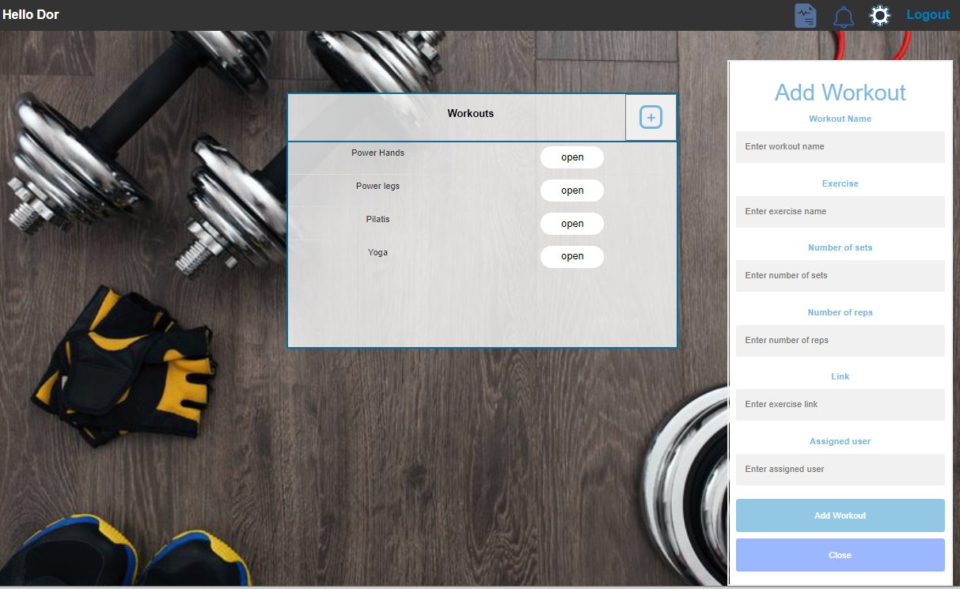

Slide 6

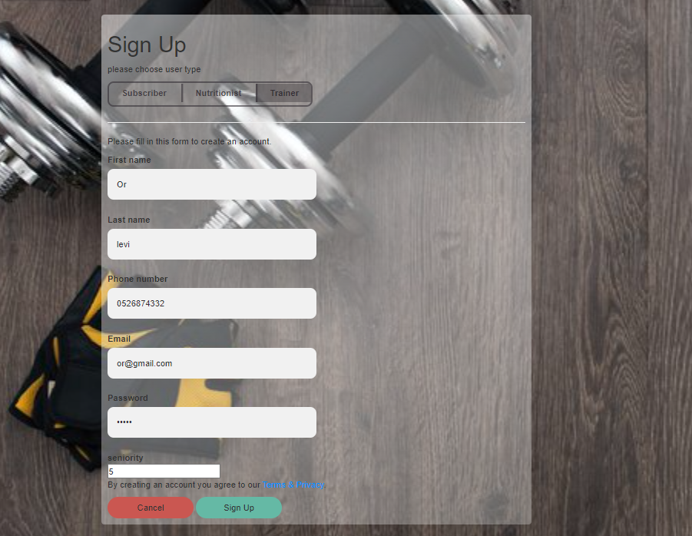

Slide 7
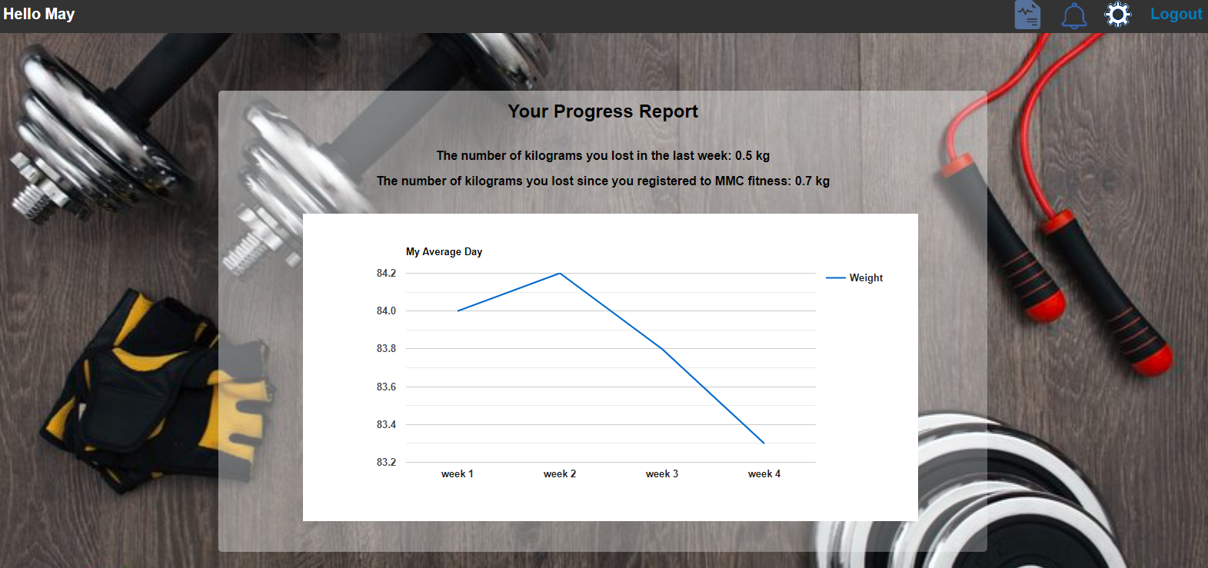

Slide 8
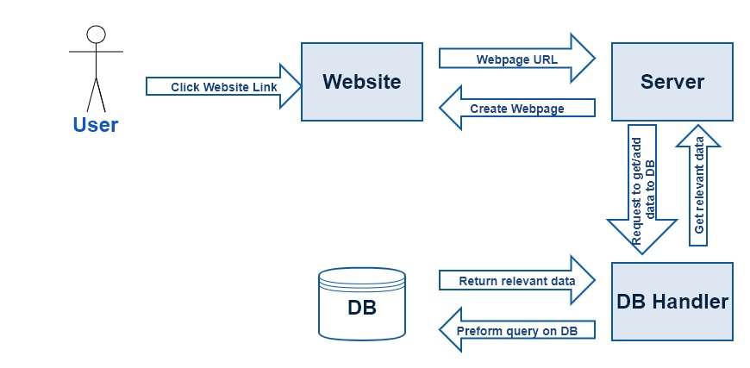





SQL

Slide 9
Different Solutions:
There are a lot of other applications, websites and other platforms that bring the fitness aspect and workout aspect apart.
Most of the solutions not friendly to those who have physical limitation or Dietary limitation and give them a solution as well.
Our website give various of people the best solution that fit for them, and not the other way around.

Slide 10
Summary:
This solution is very important for people.
Most of the people that start to “get healthy” do it only in one level , or fitness or physical activity.
In our website they can do both things in the same platform, while it considered their limitation and fit for them the relevant plan.

